Slide 1
Meditation
Sensing into the present
What does it feel like when you connect with these two different statements:
  I am being breathed
  I am breathing

Slide 2
Going down to come up
Taking a walk
Sun (effort)/moon (magnet for the ocean)
Music (proactivity/reactivity) (impulse/thought)

Slide 3
Using the mind for what it was made for:
What does the mind do well?
Well
Perceiving when breath needs to be controlled consciously vs subconsciously
Analyzing information
Effortful planning, putting brakes on
Poorly
Control the breath in day to day
Being comfortable with uncertainty
Taking breaks
Quieting down

Slide 4
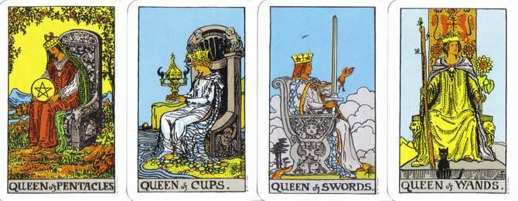
Balancing different ways of knowing

Slide 5
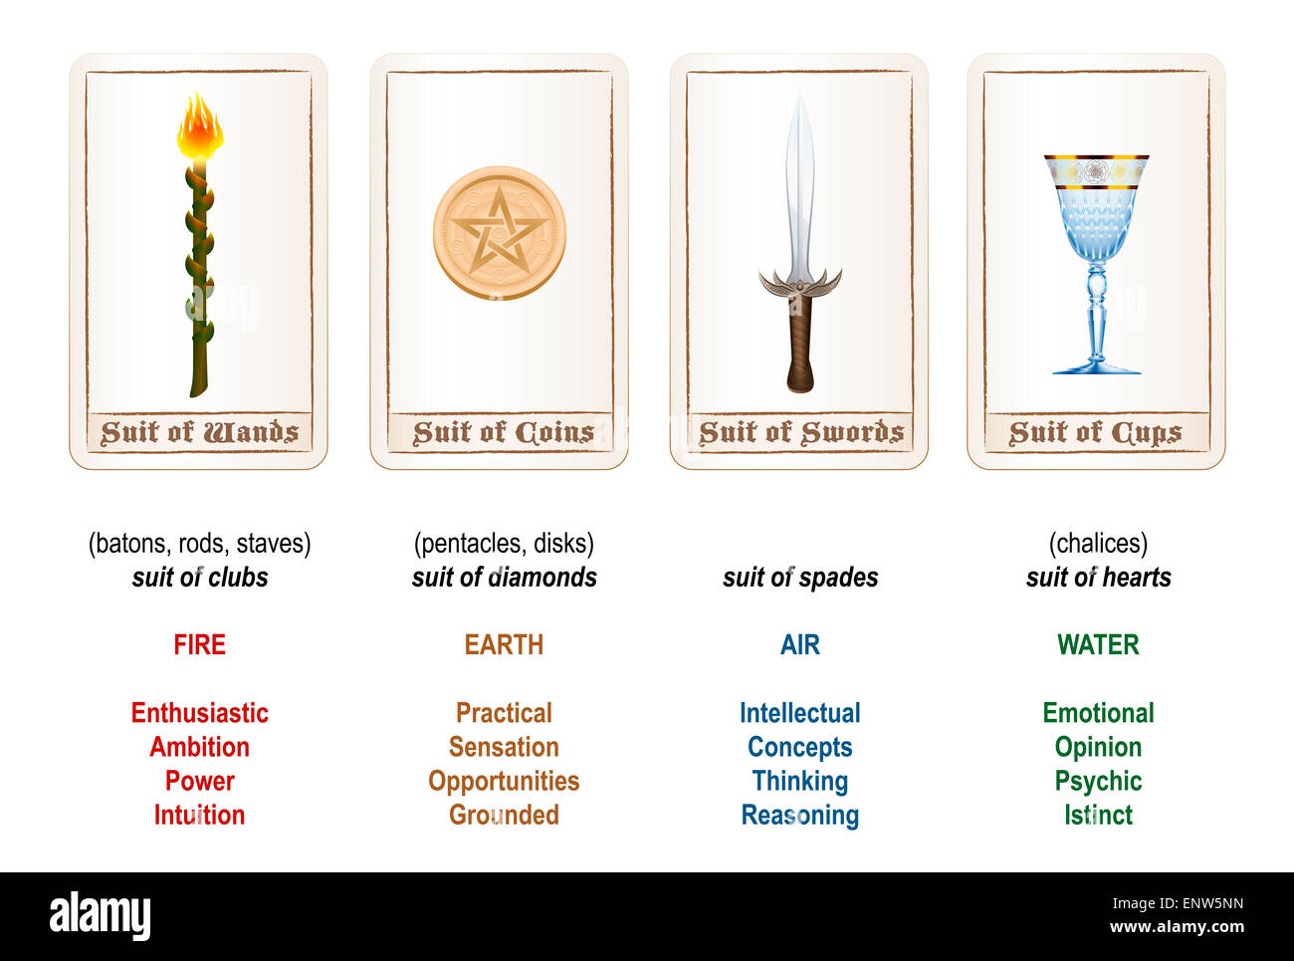

Slide 6
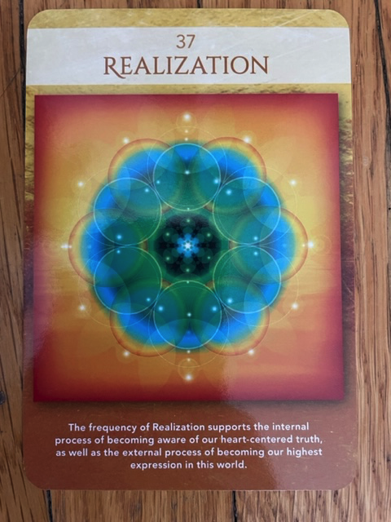

Slide 7
Ways of working with the mind:
Habit mapping, bullet journaling, the work
Mind vomiting, writing things down, logorrhea https://www.etymonline.com/word/logorrhea
Free writing, journaling, automatic writing
Give the mind something else to focus on

Slide 8
The Work
https://thework.com/instruction-the-work-byron-katie/

Slide 9
Reward-Based Learning
Trigger>behavior>reward
Dr. Jud Brewer
  TED talk https://drjud.com/a-simple-way-to-break-a-bad-habit/
  Practice: https://drjud.com/a-simple-way-to-break-bad-habits/#id7

